Slide 1
Improved Source of Drinking Water
CAPSTONE PROJECT
Presented By:
Arijit Mandal
SRM Institute of Science and Technology
CSE (Data Science)

Slide 2
OUTLINE
Problem Statement
Proposed System/Solution
System Development Approach
Algorithm & Deployment
Result (Output Image)
Conclusion
Future Scope
References

Slide 3
Problem Statement
This project focuses on analyzing data from the 78th Round of the Multiple Indicator Survey to understand how many people in India have access to improved sources of drinking water. It will also explore related factors like clean cooking fuel usage and migration trends. The aim is to identify regional and social inequalities in access to clean water. The findings will help support fair and informed policy decisions to achieve Sustainable Development Goals (SDGs). Ultimately, the goal is to promote safe, equitable, and sustainable access to basic services for all

Slide 4
Proposed Solution
Develop a data-driven analytical model to assess and predict access to improved drinking water sources using the 78th Round of the Multiple Indicator Survey (MIS) dataset. The model will process socio-demographic and regional indicators to identify areas with low access, enabling targeted policy interventions and improved water resource planning.
Data Collection: Use the 78th Round Multiple Indicator Survey (MIS) dataset by NSSO, which includes state-wise, gender-wise, sector-wise, and age group data on access to improved drinking water and related
Preprocessing:
Clean and structure the dataset.
Encode categorical variables like gender, sector, and state.
Normalize and prepare features for modeling.
Model Training: Train a regression model to predict the percentage of population with access to improved drinking water based on socio-economic and geographic factors.
Evaluation: Validate the model using metrics such as R² score, Mean Absolute Error (MAE), and Root Mean Squared Error (RMSE) to ensure accuracy and reliability.

Slide 5
System Approach
The "System Approach" section outlines the overall strategy and methodology for developing and implementing the rental bike prediction system. Here's a suggested structure for this section:
System requirements :
IBM Cloud (mandatory)
IBM Watson studio for model development and deployment
IBM cloud object storage for dataset handling

Slide 6
Algorithm & Deployment
Algorithm Selection:
Random Forest Classifier (or SVM based on performance)
Data Input:
State , Age, Group ,Sector, Gender , Indicator from the dataset
Training Process:
Supervised learning approach using percentage of population with access to improved drinking water as the target variable . Handling missing values , Label encoding of categorical variables
Prediction Process:
Model deployed on IBM Watson Studio with API endpoint for real-time predictions

Slide 7
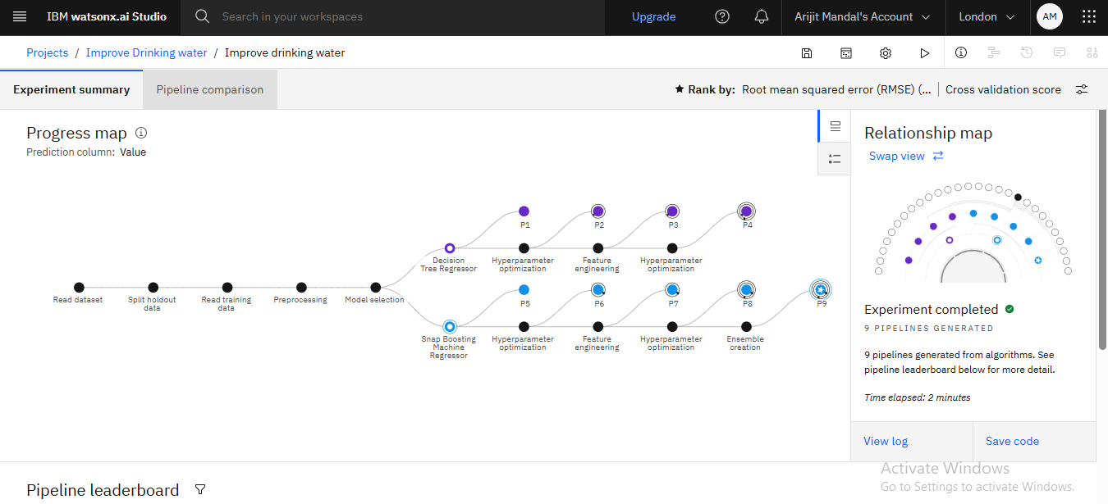
Result

Slide 8
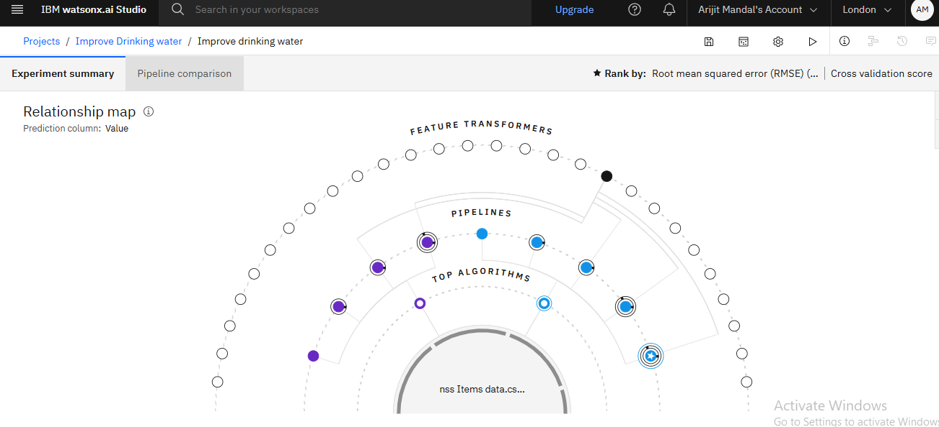
Result

Slide 9
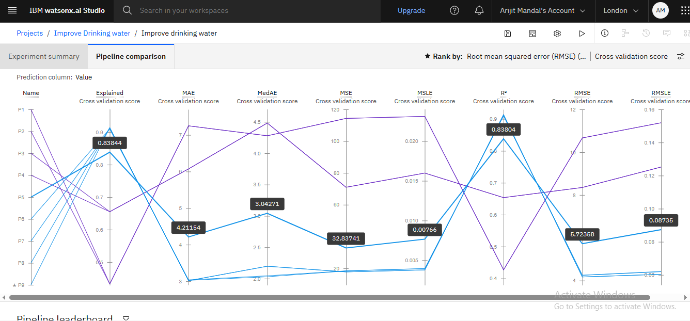
Result

Slide 10
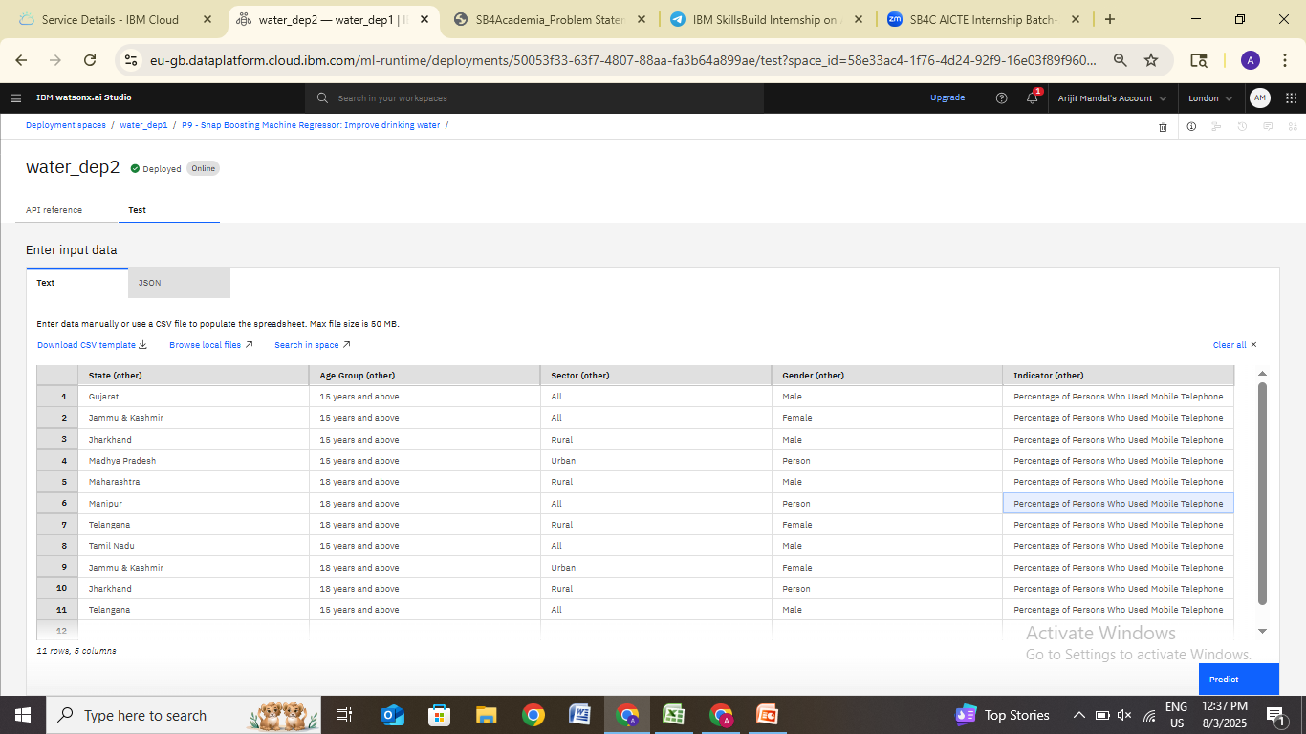
Result

Slide 11
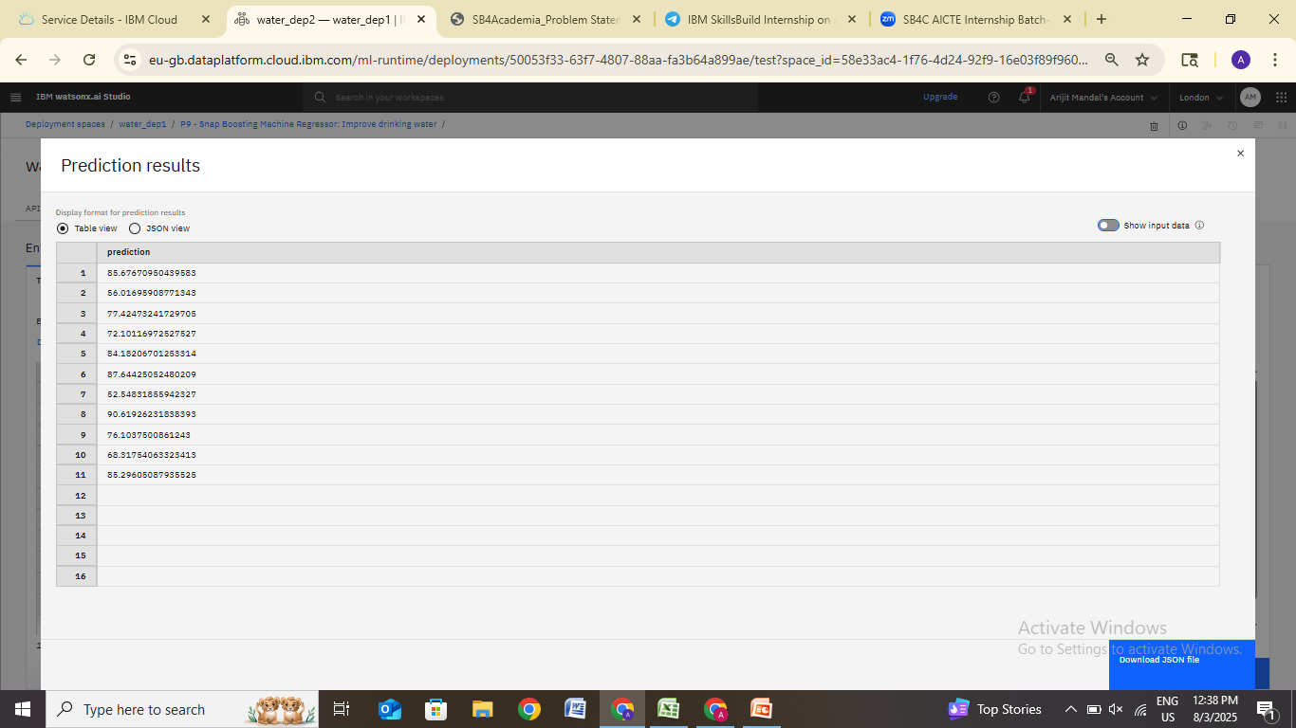
Result

Slide 12
Conclusion
Summarize the Significant differences in water access across regions and groups,Predictive models can assist in targeting interventions , Data shows the need for focused rural policies

Slide 13
Future scope
Integrate additional variables like weather conditions and migration data for deeper analysis. Develop interactive dashboards using tools like Tableau or Power BI for better visualization. Expand the model to include sanitation and public health indicators. Enhance prediction accuracy by using real-time data updates from government sources.

Slide 14
References
National Sample Survey Office (78th Round)
Government of India SDG Reports
https://aikosh.indiaai.gov.in/web/datasets/details/improved_source_of_drinking_water_ multiple_indicator_urvey_78th_round.html

Slide 15
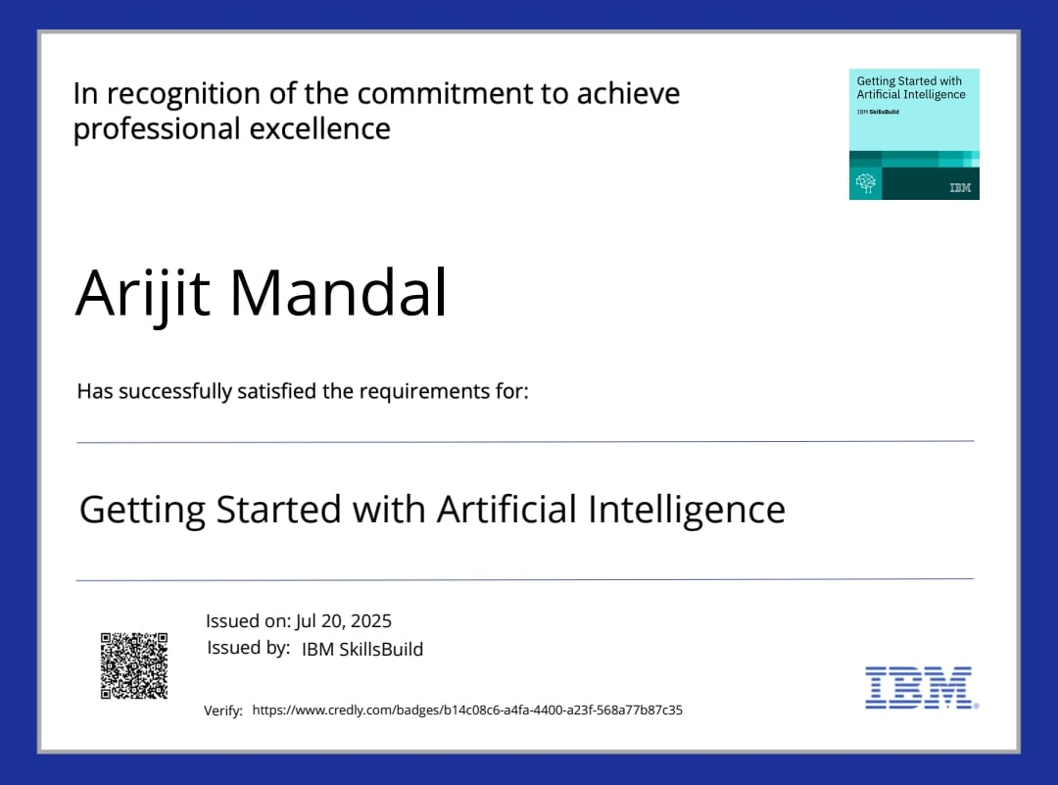
IBM Certifications

Slide 16
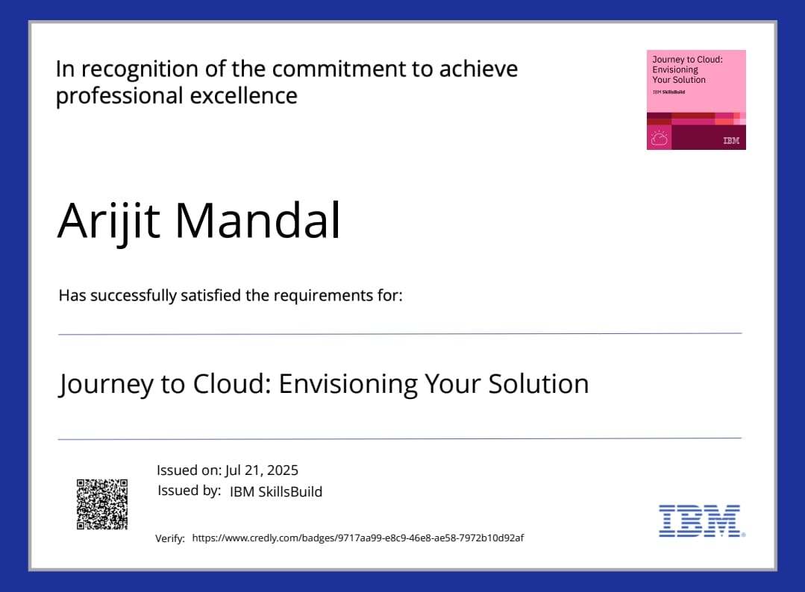
IBM Certifications

Slide 17
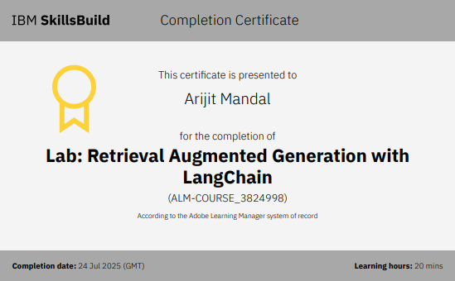
IBM Certifications

Slide 18
THANK YOU

